Slide 1


SARVAJANIK COLLEGE OF ENGINEERING AND TECHNOLOGY
BRANCH
INFORMATION TECHNOLOGY(016)

Slide 2

Easy Tow

Slide 3
Presented By
Enrolment No. | Name
150420116013 | Dixit Palak
150420116016 | Gandhi Khyati
150420116032 | Patel Nishi
150420116052 | Sonawala Raj
GUIDE: PROF. TUSHAR GOHIL
CO-GUIDE: PROF. VIVAKSHA JARIWALA

Slide 4
Description
Day to day in cities, population is increasing which leads to increase in vehicles. In this condition, we don’t have sufficient parking place. Thus vehicle owner will park in illegal parking zone.
This also leads to increase in traffic. Tow department will tow that vehicle without user being aware.
User can’t easily find weather the vehicle has been towed, stolen or misplaced. Here our easy-tow comes in picture.
Easy-tow will help user to know where his vehicle has been towed and will give the exact location.

Slide 5
This Application provides owner the platform to pay online fine.
It promotes the concept of digital payment.
A small step towards Anti-corruption concept.
Moreover user can get nearby location of available parking.

Slide 6
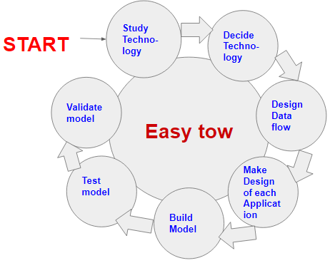
Project Plan

Slide 7










Existing Solutions
Solutions
Call help Line
Use Vehicle Tracker
Manual
Disadvantages
More time Consuming
Costly
Waste of paper
No record Maintain properly
Less efficient
Owner don’t know that their vehicle is tow or stolen.

Slide 8

Our Solutions
Inform owner their vehicle is towed and their vehicle destination.
User can find nearest parking areas.
Provides online platforms for fine payment , stops corruption and promotes Digitalization.
Stores and Manage data about owner and vehicle.
That data is used for taking important decisions.

Slide 9
Unique Features
Online Payment(via Paytm)
Destination location
Maintaining history
Nearby parking
Image scanning

Slide 10


Software Requirement
Android Studio.
Visual Studio Code.
Library requirement
Firebase.
Mobile Vision.
Paytm.
Gateway.
Google Map.

Slide 11
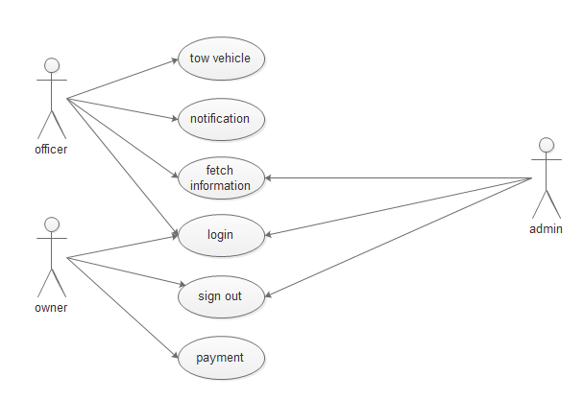
Use-Case Diagram

Slide 12
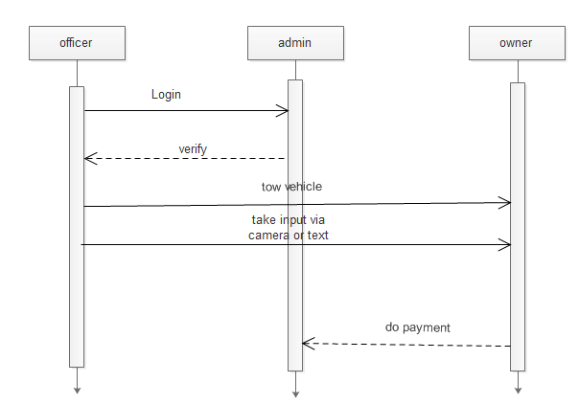
Sequence Diagram

Slide 13
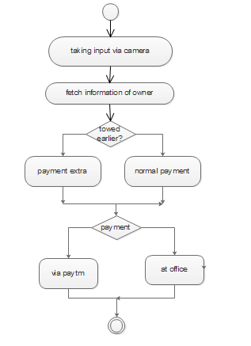
Activity diagram
yes
no
yes

Slide 14
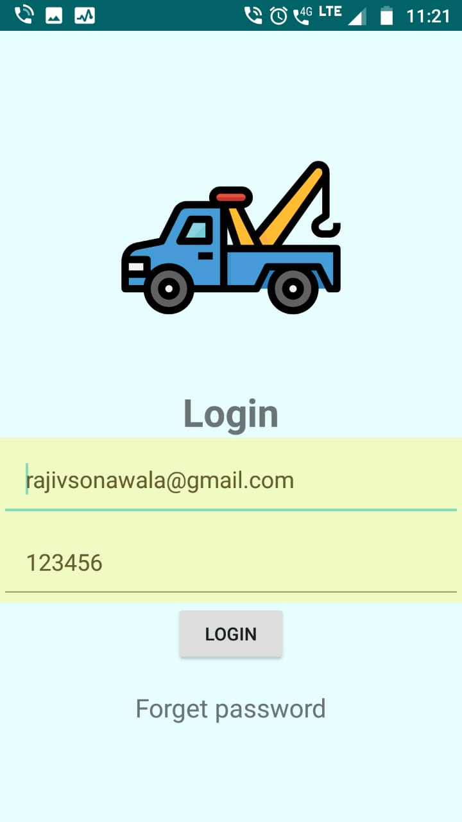

Screenshots of implementation

Slide 15
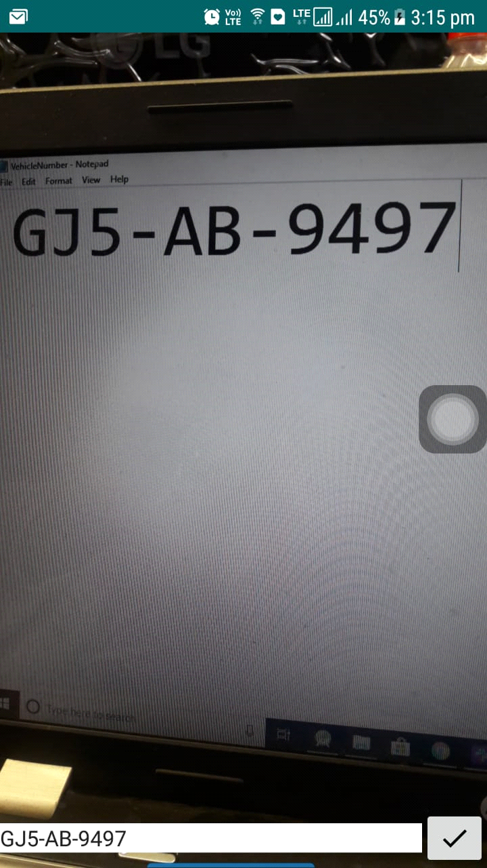
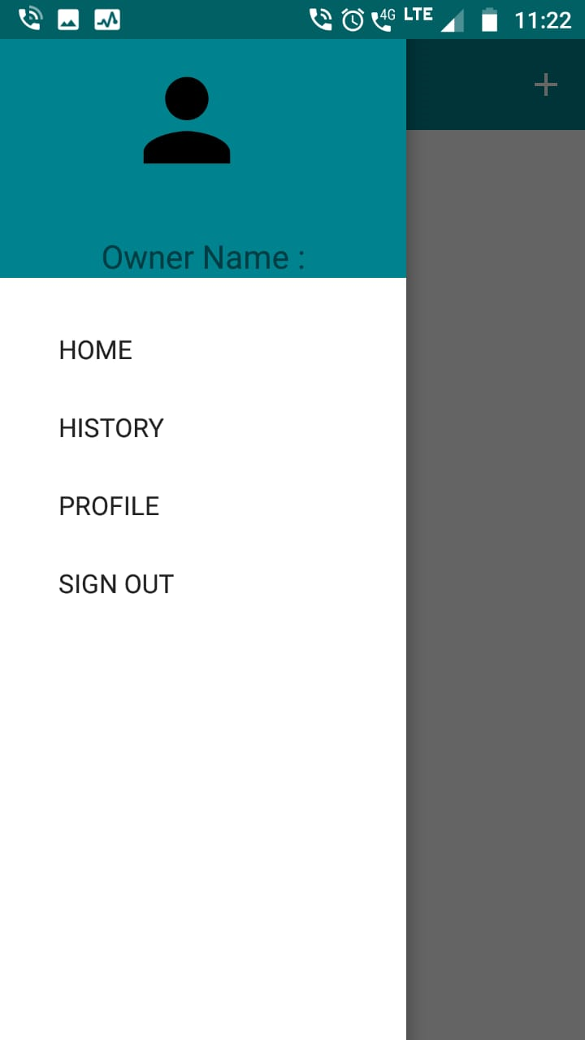

Slide 16
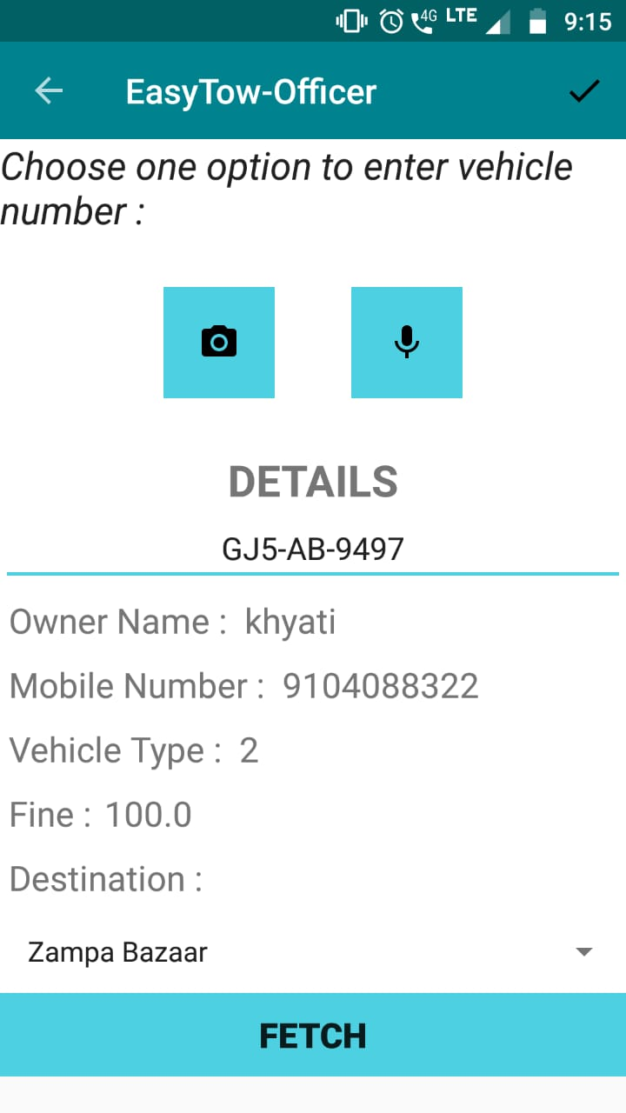
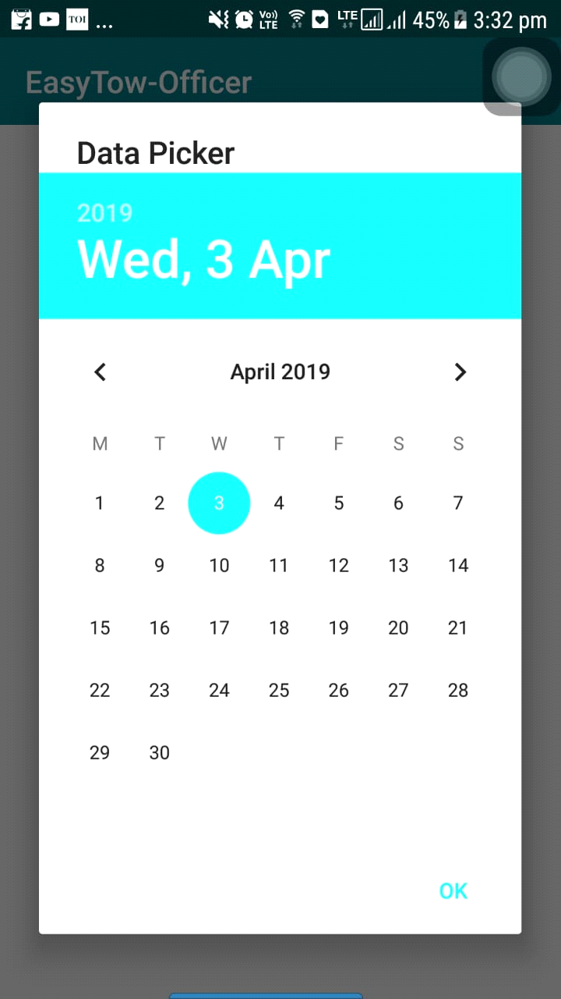

Slide 17
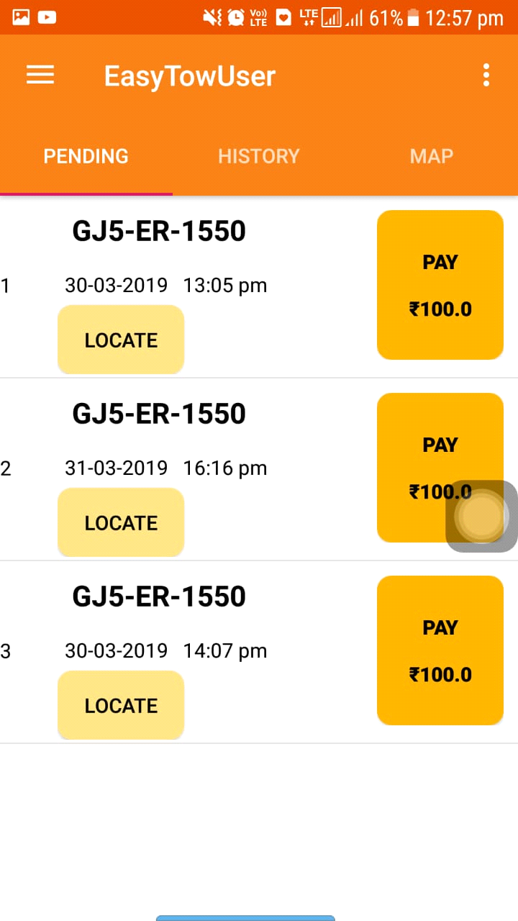
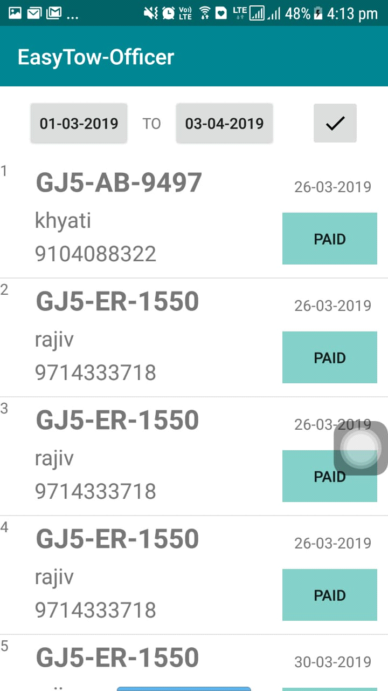

Slide 18
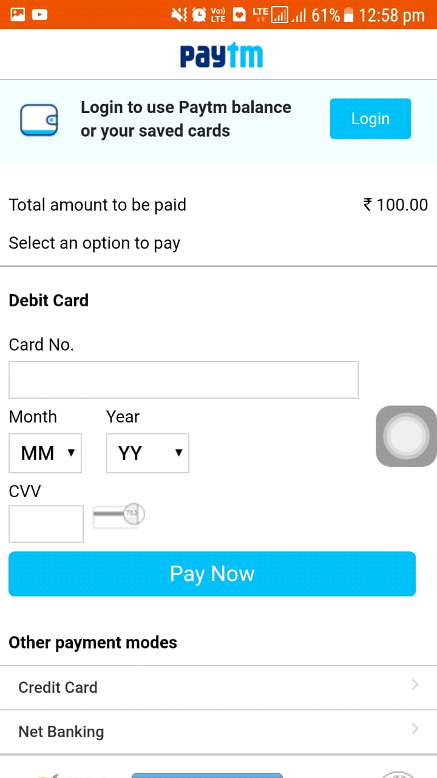
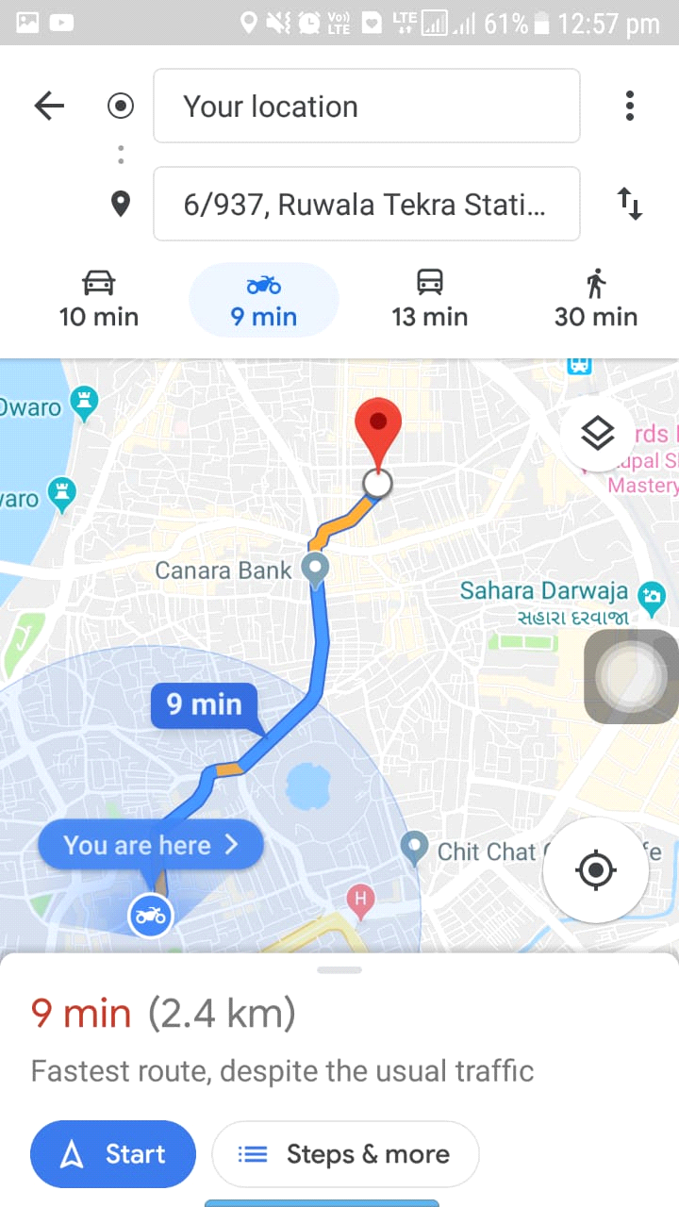

Slide 19
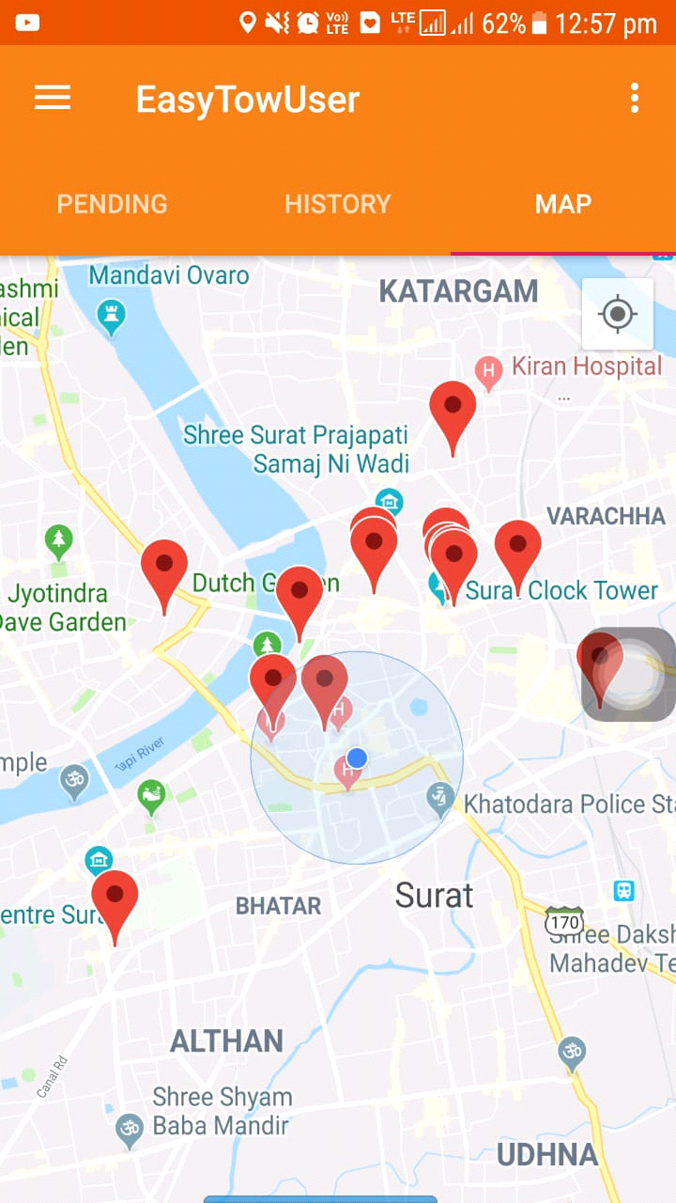
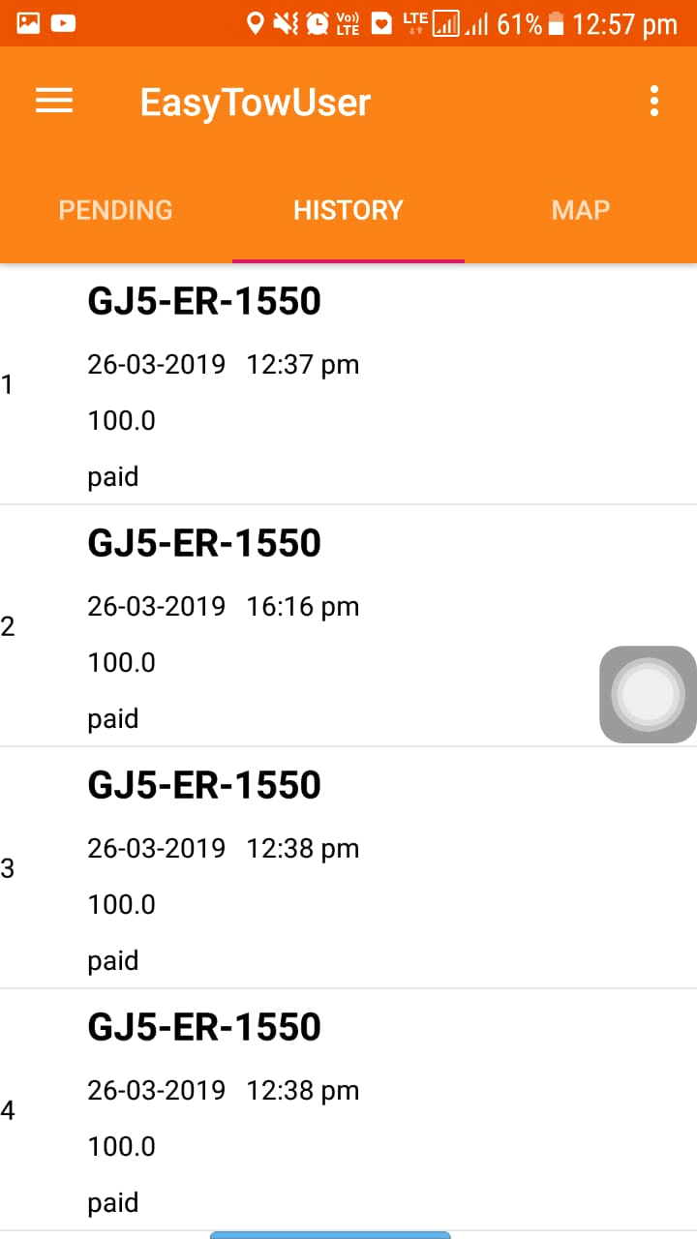

Slide 20
Future Scope
Website
Speech to text
SMS
Track location
RTO

Slide 21
Conclusion
Easy tow is smartest and digital way towards towing system. Since it is online system, maintaining record and handle the user’s payment with transparency and accurately will possible. With the help of this project, government and vehicle-owner both’s work will become easy in the matter of towing due to online and digital payment system.

Slide 22



Reference
Google patents available @:
https://patents.google.com/?q=vehicle&q=towing&q=system&oq=vehicle+towing+system
Firebase Guides | Firebase available @:
https://firebase.google.com/docs/guides/?authuser=0

Slide 23

Thank You.

